Slide 1
Section 6.2
Calculating Coefficients
of Generating Functions

Slide 2
Calculating Coefficients Of
Generating Functions
This chapter is about developing algebraic techniques for calculating the coefficients of generating functions.
All methods seek to reduce a given generating function to a simple binomial–type generating function, or a product of binomial-type generating functions.

Slide 3
Polynomial Expansions:
1)
2)
3)
4)
5)
If h(x)=f(x)g(x), where f(x) and g(x) , then
h(x)

Slide 4
If h(x)=f(x)g(x), where f(x) and g(x) , then
h(x)
The rule for multiplication of generating functions in Eqn. (6) is simply the standard formula for polynomial multiplication.

Slide 5
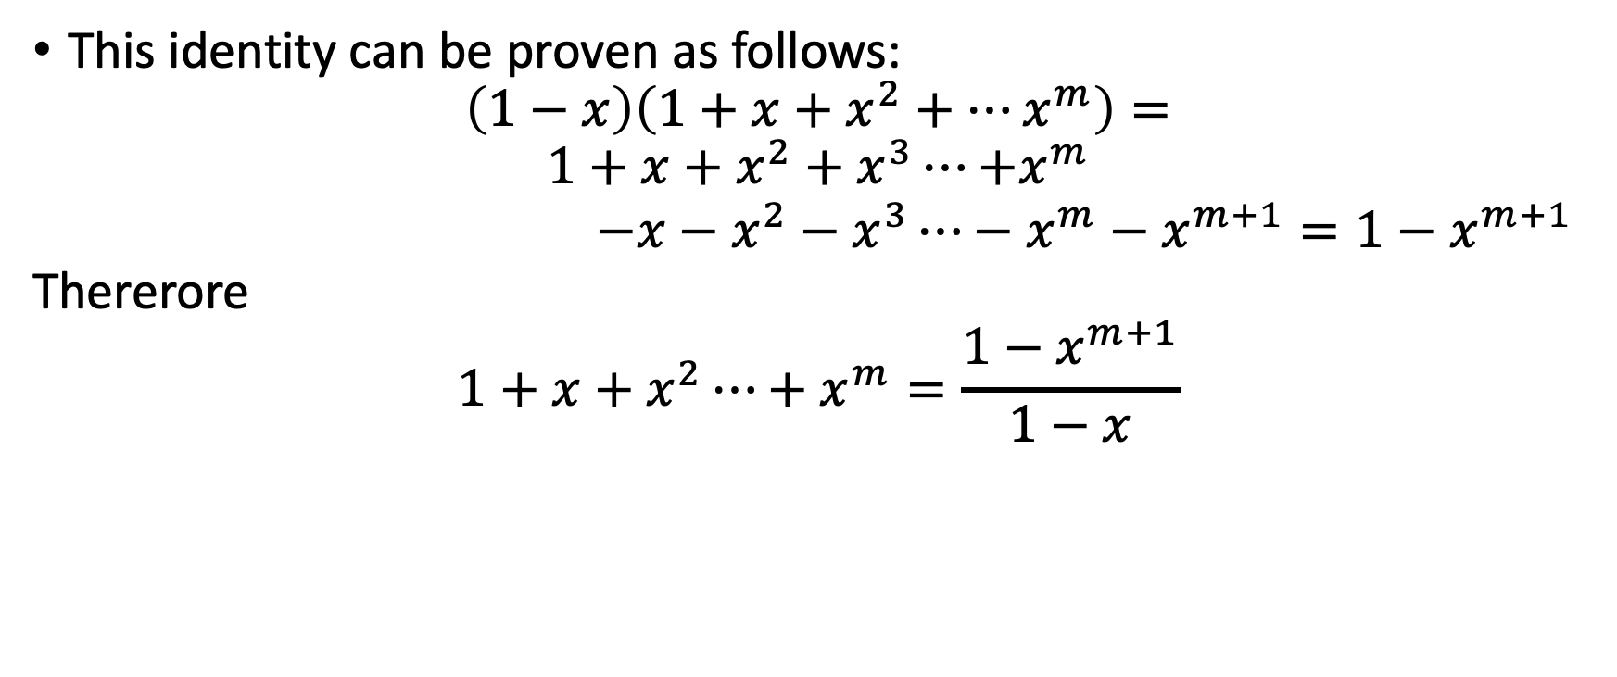
1)
This identity can be proven as follows:
$$\left(1−x\right)\left(1+x+x^{2}+⋯x^{m}\right)=$$
$$\begin{matrix}1+x+x^{2}+x^{3}⋯{+x}^{m} \\ −x−x^{2}−x^{3}⋯−x^{m}−x^{m+1}=1−x^{m+1}\end{matrix}$$
Thererore
$$1+x+x^{2}⋯+x^{m}=\frac{1−x^{m+1}}{1−x}$$

Slide 6

In (1), we consider $\left|x\right|<1$, then $x^{m}→0$ as $m→∞$, and we have (2)
1)
2)

Slide 7
3)
Expansion (3), the binomial expansion was explained at the start
of section 6.1. Expansion (4) is obtained from (3) by expanding

Slide 8
5)
^{n}
1
For identity (5), ( 1 – x)^{-n} = = ( 1 + x + x² + … ) ^{n}
Since = ( 1 + x + x² + … ) (eq. 2)
Let us determine the coefficient in equation (7) by counting the number of formal products whose sum of exponents is r, if ei represents the exponent of the ith term in a formal product , then the number of formal products whose exponents sum to r is the same as the number of integer solutions to the equation
In example 5, section 5.4 we showed that the number of nonnegative integer solutions to this equation is C(r + n –1,r ) , so the coefficient in eqn (7) is
C(r + n –1,r ) . This verifies expansion (5).
1 - x
1
2)
1 - x

Slide 9
1)
3)
5)
If h(x)=f(x)g(x), where f(x) and g(x) , then
h(x)
With formulas (1) and (6) we can determine the coefficients of a variety of generating functions: first, perform algebraic manipulations to reduce a given generating function to one of the forms or a product of two such expansions, then use expansions (3) and (5) and the product rule (6) to obtain any desired coefficient.

Slide 10
Example 1
Find the coefficient of
To simplify the expression, we extract from each polynomial factor and
then apply identity (2).
Thus the coefficient of x¹⁶ in x¹⁰ (1-x) ^{–5} is the coefficient of the x⁶ term in (1-x) ^{–5}
[i.e., the x⁶ term in (1-x) ^{–5} is multiplied by to become the x¹⁶ term in
x¹⁰ (1-x) ^{–5} ]

Slide 11
Example 1 continued
5)
From expansion (5) we see that the coefficient of
More generally, the coefficient of x^{r} in

Slide 12
Example 2
If h(x)=f(x)g(x), where f(x) and g(x) , then
h(x)
Use generating functions to find the number of ways to collect $15 from 20 distinct people if each of the first 19 people can give a dollar (or nothing) and the twentieth person can give either $1 or $5 (or nothing).
The generating function for the number of ways to collect r dollars from these people is (1+x)¹⁹(1+x+x ⁵). We want the coefficient of x¹⁵. The first part of this generating function has the binomial expansion
( )
19
( )
19
( )
19
( )
19
(1+x)¹⁹ = 1 + x + x²+ … + x^{r}+ … + x¹⁹
1
2
r
19
If we let f(x) be this first polynomial and let g(x) = 1+x+x⁵, then we can use Eq. (6) to calculate the coefficient of x¹⁵ in h(x) = f(x)g(x). Let a_{r} be the coefficient of x^{r} in f(x) in f(x) and b_{r} the coefficient of x^{r} in g(x). We know that
( )
19
a_{r} = and that b₀ = b₁ = b₅ = 1 (other b_{i}s are zero).
r

Slide 13
Example 2 continued
If h(x)=f(x)g(x), where f(x) and g(x) , then
h(x)
Then the coefficient of of x¹⁵ in h(x) is
a₁₅b₀ + a₁₄b₁ + a₁₃b₂ + … + a₀b₁₅
which reduces to
a₁₅b₀ + a₁₄b₁ + a₁₀b₅
since b₀, b₁, b₅ are the only nonzero coefficients in g(x). Substituting the values of the various as and bs in Eq. (6), we have
( )
19
( )
19
( )
19
( )
19
( )
19
( )
19
x 1 + x 1 + x 1 = + + .
15
14
10
15
14
10

Slide 14
Review of the generating function identities:
1)
2)
3)
4)
5)
If h(x)=f(x)g(x), where f(x) and g(x) , then
h(x)

Slide 15
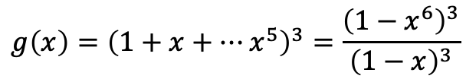
$$g\left(x\right)={\left(1+x+⋯x^{5}\right)}^{3}=\frac{{\left(1−x^{6}\right)}^{3}}{{\left(1−x\right)}^{3}}$$

Slide 16
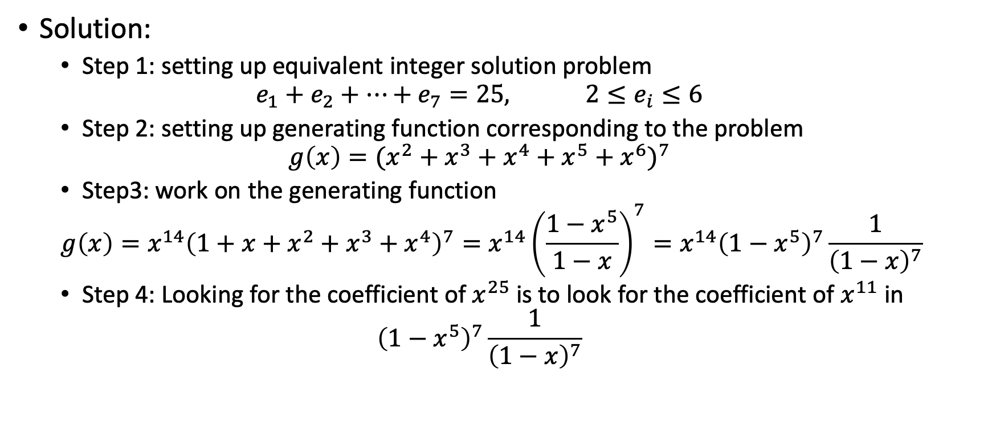
How many ways are there to select 25 toys from seven types of toys with between two and six of each type?
Solution:
Step 1: setting up equivalent integer solution problem
$$e_{1}+e_{2}+⋯+e_{7}=25, 2≤e_{i}≤6$$
Step 2: setting up generating function corresponding to the problem
$$g\left(x\right)={(x^{2}+x^{3}+x^{4}+x^{5}+x^{6})}^{7}$$
Step3: work on the generating function
$$g\left(x\right)=x^{14}{\left(1+x+x^{2}+x^{3}+x^{4}\right)}^{7}=x^{14}{\left(\frac{1−x^{5}}{1−x}\right)}^{7}=x^{14}{\left(1−x^{5}\right)}^{7}\frac{1}{{\left(1−x\right)}^{7}}$$
Step 4: Looking for the coefficient of $x^{25}$ is to look for the coefficient of $x^{11}$ in
$${\left(1−x^{5}\right)}^{7}\frac{1}{{\left(1−x\right)}^{7}}$$

Slide 17
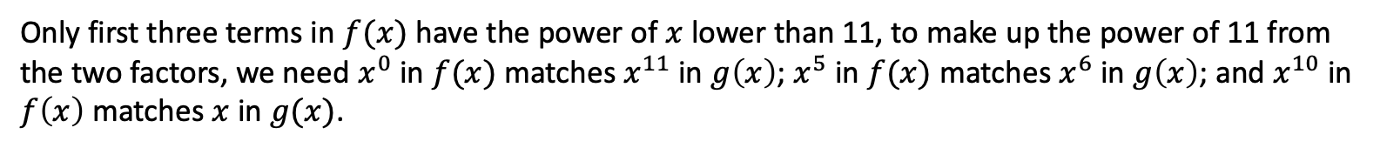
Let f(x) = (1 - x⁵)⁷ and g(x) = (1 - x)⁻⁷ . By expansions (4) and (5), respectively, we have
Only first three terms in $f(x)$ have the power of $x$ lower than 11, to make up the power of 11 from the two factors, we need $x^{0}$ in $f(x)$ matches $x^{11}$ in $g\left(x\right)$; $x^{5}$ in $f(x)$ matches $x^{6}$ in $g\left(x\right)$; and $x^{10}$ in $f\left(x\right)$ matches $x$ in $g(x)$.

Slide 18
Section 7.1
Recurrence Relations

